Slide 1
Text Mining and Natural Language Processing

Slide 2
Motivation for Text Mining
Approximately 80% of the world’s data is held in unstructured formats
To extract value from unstructured data we need to move from simple document retrieval to “knowledge” discovery.
Structured Numerical or Coded
Information
20%
Unstructured or Semi-structured
Information
80%
Notes:
The justification for the interest in text mining is the same as for the interest in knowledge retrieval (search and categorization).
The shear amount of unstructured data (mostly textual) out there calls for more than just document retrieval. Tools and techniques exist to mine this data and realize value in the same way that data mining taps structured data for business intelligence and knowledge discovery.

Slide 3
How Unstructured is “Unstructured”?
“Weakly Structured” data: few structural cues to text based on layout or markups
Research papers
Legal memoranda
News Stories
“Semi structured” data: extensive format elements, metadata, field labels
Email
HTML web pages
PDF files

Slide 4
Challenges of Text Mining
Very high number of possible “dimensions”
All possible word and phrase types in the language!!
Unlike data mining:
records (= docs) are not structurally identical
records are not statistically independent
Complex and subtle relationships between concepts in text
“AOL merges with Time-Warner”
“Time-Warner is bought by AOL”
Ambiguity and context sensitivity
automobile = car = vehicle = Toyota
Apple (the company) or apple (the fruit)
The same words can mean different things (homographs)
Bear (verb) - to support or carry
Bear (noun) - a large animal
Different words can mean the same thing (synonyms)
Mispellings, abbreviations, spelling variants
Notes:
Why aren’t there more products that do text mining?
Because it’s hard!!!
First, there are many possible dimensions of text. Consider just the classes of nouns that might be represented in a text collection. Then, add to that noun phrases (nouns plus adjectives or multi-word concepts).
Second, different documents can look quite different. Never mind issues like formatting differences.
Third, the relationships between words and concepts in text is subtle. Figuring out that a relationship exists is easy, providing the information about the nature of the relationship is tricky.
Finally, the same word can have many meanings (e.g. “interest”), or many words can have the same meaning.

Slide 5
Four Text Mining Ambiguities
Homonymy: same word, different meaning. An example is the word bank as it appears in "river bank" and "savings bank."
Polysemy: same word, but different, albeit related meaning
"The word good has many meanings. For example, if a man were to shoot his grandmother at a range of five hundred yards, I should call him a good shot, but not necessarily a good man.“ - G.K. Chesterton
Homonymy obtains when two words accidentally have the same form, such as bank 'land bordering on a river' and bank 'financial institution.' Polysemy obtains where one word has several similar meanings, such as may indicating 'permission' (e.g., May I go now?) and may indicating possibility (e.g., It may never happen).
Synonymy: synonyms, different words, similar or same meaning; can use one word for another without changing the meaning of the sentence substantively.
Hyponymy: hyponym is a term used to designate a particular member of a broader class. For instance, daisy and rose are hyponyms of flower. Also called a subtype or a subordinate

Slide 6
“Search” versus “Discover”
Search
(goal-oriented)
Discover
(opportunistic)
Structured
Data
Data
Retrieval
Data
Mining
Unstructured
Data (Text)
Information
Retrieval
Text
Mining

Slide 7
Seven types of text mining
Search and Information Retrieval (IR): Storage and retrieval of text documents, including search engines and keyword search
Document Clustering: Grouping and categorizing terms, snippets, paragraphs or documents using data mining clustering methods
Document Classification: Grouping and categorizing snippets, paragraphs, or document using data mining classification methods, based on models trained on labeled examples.
Web Mining: Data and Text Mining on the Internet with a specific focus on the scale and interconnectedness of the web.
Information Extraction (IE): Identification and extraction of relevant facts and relationships from unstructured text; the process of making structured data from unstructured and semi-structured text
Natural Language Processing (NLP): Low-level language processing and understanding tasks (e.g., tagging part of speech); often used synonymously with computational linguistics
Concept Extraction: Grouping of words and phrases into semantically similar groups

Slide 8
Terminology
Corpus - A body of texts is called a corpus which is simply Latin for ‘body,’ and when you have several such collections of texts, you have corpora. Corpus can be regarded as a collection of discreet documents.
Document – A document regarded as a collection of discreet terms
Term – Usually a word but not always necessarily so.
Collocation - A COLLOCATION is an expression consisting of two or more words that correspond to some conventional way of saying things. Collocations include noun phrases like strong tea and weapons of mass destruction, phrasal verbs like to make up, and other stock phrases like the rich and powerful. They often have a specialized meaning or are idiomatic, but they need not be.
Compositionality - We call a natural language expression compositional if the meaning of the expression can be predicted from the meaning of the parts. Collocations are characterized by limited compositionality.

Slide 9
Terminology
N-gram - is a sequence of N words: a 2-gram (or bigram) is a two-word sequence of words like “please turn”, “turn your”, or ”your homework”, and a 3-gram (or trigram) is a three-word sequence of words like “please turn your”, or “turn your homework”
When computing the n-grams you typically move one word forward (although you can move X words forward in more advanced scenarios)
Word boundary - Ending point of a word and beginning of the next word is called word boundaries
Tokenization - Given a character sequence tokenization is the task of chopping it up into pieces, called tokens , perhaps at the same time throwing away certain characters, such as punctuation. It can be thought of as the process of segmenting running text into words, punctuations, numbers and sentences.
Stop Words - They are common words that do not contribute much to the content or meaning of a document. E.g. a, an, and, are, as, at, be, but, by, for

Slide 10
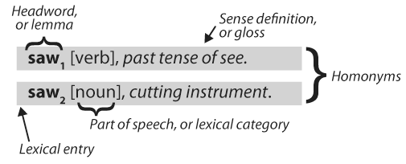
Terminology
Grammar – The rules of a language
Semantics - Semantics is the study of meaning (as opposed to form/syntax, for example) in language. Normally semantics is restricted to "meaning out of context" - that is, to meaning so far as it can be determined without taking context into account.
Part of Speech (POS) - The role, like noun, verb, adjective, adverb, pronoun, preposition, etc. that a word is either playing in a particular sentence (e.g. like is acting as a preposition in I like pizza) or that it can play in some sentence: e.g. like can act as a verb, noun, adjective, adverb, preposition, and conjunction. POS is also known as lexical category
Lexicon - A lexicon, or lexical resource, is a collection of words and/or phrases along with associated information, such as part-of-speech and sense definitions. “Dictionary” of NLP system

Slide 11
Terminology
Morphology - is the study of the structure and formation of words
Inflections - Nouns are inflected to form plurals, usually by adding “s”, Adjectives are inflected to form comparative (er) and superlative (est) forms. Verbs inflect with “ed” or “ing”
Stemming - is a technique to remove affixes (suffix, prefix etc.) from a word, ending up with the stem
Lemmatization - is the process of converting the words of a sentence to its dictionary form.
The goal of both stemming and lemmatization is to reduce inflectional forms and sometimes derivationally related forms of a word to a common base form. For instance: car, cars, car's, cars' => car
Stemming usually refers to a crude heuristic process that chops off the ends of words in the hope of achieving this goal correctly most of the time, and often includes the removal of derivational affixes. Lemmatization usually refers to doing things properly with the use of a vocabulary and morphological analysis of words, normally aiming to remove inflectional endings only and to return the base or dictionary form of a word. For instance: amusement, amusing, and amused => amuse

Slide 12
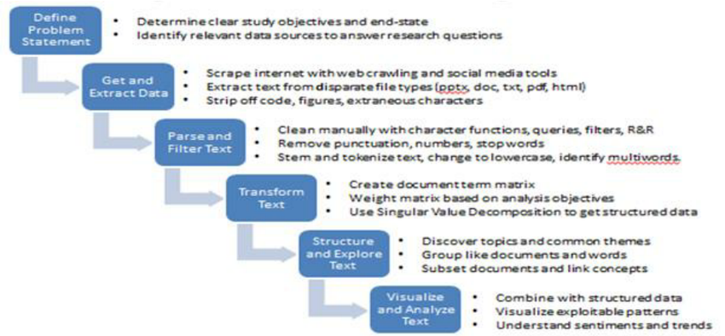
Steps in Text Mining

Slide 13
Steps in Text Mining
1. Data Collection
a. Acquire data
b. Convert data into plain text
2. Remove Duplicate Entries
3. Text Parsing and Extracting Features
a. Tokenization
b. Parsing
i. Remove HTML characters
ii. Decode complex symbols to UTF-8
iii. Spell check
iv. Apostrophe look-up
v. Remove punctuation marks
vi. Remove expressions / emojis
vii. Split attached words
viii. Slangs look-up
ix. Remove URLs
c. Lemmatization / Stemming (Normalization of Tokens)
d. Parts-of-Speech Tagging
4. Text Filtering
a. Remove start-words
b. Remove stop-words
c. Remove irrelevant words based on frequency
5. Text Transformation
a. Bag of Words Representation
b. TF-IDF (term frequency–inverse document frequency)
6. Text Mining / Analysis
a. Text Categorization/Classification
b. Topic Modeling
d. Text Clustering
e. Similarity Analysis
f. Sentiment Analysis

Slide 14
Application understanding; Corpus generation
What is the question?
What is the context?
What could be interesting sources, and where can they be found?
Use an existing corpus
Crawlers
Use a search engine and/or archive and/or API
Preprocessing
Goal: get clean ASCII text
Remove HTML markup, pictures, advertisements, ...
Goal: get processable lexical / syntactical units
Tokenize (find word boundaries)
Case folding: in bicameral (two-case) scripts (e.g. Latin, Greek), reduce all letters to one (e.g. lower) case
Lemmatize / stem (in inflected languages, reduce words to base forms. Porter Stemming algorithm)
Remove stopwords (remove common words that do not carry meaning)
Find Named Entities (people, places, companies, ...); filtering
Resolve polysemy and homonymy: word sense disambiguation; “synonym unification“
Part-of-speech tagging; filtering of nouns, verbs, adjectives, ...
Most steps are optional and application-dependent
Many steps are language-dependent
Creation of text representation
Goal: a representation that the modelling algorithm can work on
Most common forms: A text as a set or (more usually) bag of words / vector-space representation: term-document matrix with weights reflecting occurrence, importance, ...
a sequence of words
a tree (parse trees)
Notes:
Lena!

Slide 15
Data Collection
Web Crawling/Scraping
R library rvest can be used for scraping websites
APIs
Twitter API
Set up by dev.twitter.com
Can get tweets by user or can search by keywords
Library twitteR
Facebook API
Library Rfacebook
https://bigdataenthusiast.wordpress.com/2016/03/19/mining-facebook-data-using-r-facebook-api/
blsAPI for pulling U.S. Bureau of Labor Statistics data
rnoaa for pulling NOAA climate data
rtimes for pulling data from multiple APIs offered by the New York Times
Library jsonlite for directly querying websites that return a json object
JSON: JavaScript Object Notation.
JSON is a syntax for storing and exchanging data.
JSON is text, written with JavaScript object notation.

Slide 16
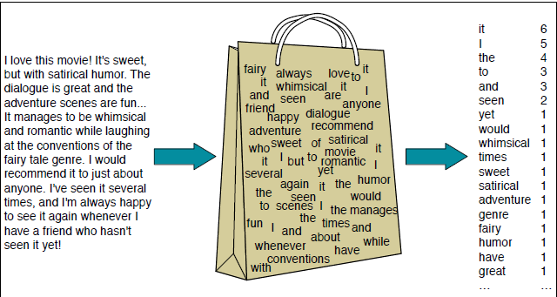
Bag of words
Represent document as “bag” of terms (known as “bag-of-words” or BOW representation)
An unordered set of words with their position ignored, keeping only their frequency in the document
A “bag” is a multiset: a set in which each element can occur more than once (equivalently, each element occurs with a count)
Bags do not retain sequential dependencies:
No phrase search
No linguistic processing
No sense of proximity

Slide 17
Term occurrences
Real-world vocabulary not closed, fixed (not just “dictionary words”), due to:
Proper names
Abbreviations, acronyms
Serial numbers, URLs, other identifiers
Terms from other languages
Mispellings
Slang
. . .

Slide 18
Distribution of term frequencies
Distribution of term frequencies in collection (either total count, or document count) follows a power law (Zipfian, long-tailed) distribution
Rank terms (or any other items) by decreasing frequency
Zipf's law states that given a large sample of words used, the frequency of any word is inversely proportional to its rank in the frequency table.
Thus the most frequent word will occur about twice as often as the second most frequent word, three times as often as the third most frequent word, etc.
Zipfian distributions will look approximately straight in log–log graphs
Most of the vocabulary will occur very infrequently
A few terms will appear in much of the collection (even if stopping is applied).

Slide 19

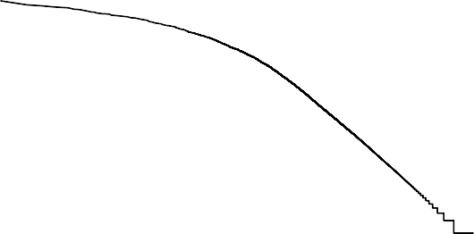
Distribution of term frequencies
4e+05
3e+05
2e+05
1e+05
0e+00
1e+06
Word frequency
Word frequency
1e+04
1e+02
1e+00
1
100
10000
Word frequency rank
0
50000 100000 150000 200000 250000
Word frequency rank
Regular graph almost perfect L shape.
In log-log graph, a “bent” straight line (typical for such distributions)

Slide 20
Collection representation
Each document is modelled as a “bag of words”
That is, as a list of terms it contains, and the count of each term
The whole collection could be modelled as a “list of bag of words”
But that fails to capture commonality of terms between documents and meaning
An alternative, and fruitful, model is called vector semantics.

Slide 21
Vector Semantics
Words that occur in similar contexts tend to have similar meanings
This link between similarity in how words are distributed and similarity in what they mean is called the distributional hypothesis.
Vector semantics is a model which instantiates this linguistic hypothesis by learning representations of the meaning of words directly from their distributions in texts.
These representations are used in every natural language processing application that makes use of meaning

Slide 22
Words, Lemmas, Senses, Definitions
lemma
sense
definition

Slide 23
Senses and relationships between senses
A sense or “concept” is the meaning component of a word
There are relations between senses
Synonymity - Synonyms have the same meaning in some or all contexts
Antonymy - Senses that are opposites with respect to one feature of meaning
antonyms can
define a binary opposition or be at opposite ends of a scale
long/short, fast/slow
Be reversives:
rise/fall, up/down
Similarity - Words with similar meanings. Not synonyms, but sharing some element of meaning
car, bicycle
cow, horse
Word relatedness - Words can be related in any way, perhaps via a semantic frame or field
car, bicycle: similar
car, gasoline: related, not similar

Slide 24
Semantic field
Words that
cover a particular semantic domain
bear structured relations with each other.
hospitals
surgeon, scalpel, nurse, anaesthetic, hospital
restaurants
waiter, menu, plate, food, menu, chef),
houses
door, roof, kitchen, family, bed

Slide 25
Relation: Superordinate/ subordinate
One sense is a subordinate of another if the first sense is more specific, denoting a subclass of the other
car is a subordinate of vehicle
mango is a subordinate of fruit
Conversely superordinate
vehicle is a superordinate of car
fruit is a subordinate of mango
Superordinate | vehicle | fruit | furniture
Subordinate | car | mango | chair

Slide 26
Connotation
Words have affective meanings
positive connotations (happy)
negative connotations (sad)
positive evaluation (great, love)
negative evaluation (terrible, hate).

Slide 27
To summarize
Concepts or word senses
Have a complex many-to-many association with words (homonymy, multiple senses)
Have relations with each other
Synonymy
Antonymy
Similarity
Relatedness
Superordinate/subordinate
Connotation
Now…
How can we build a computational model that successfully deals with the different aspects of word meaning we saw (word senses, word similarity and relatedness, lexical fields and frames, connotation)?

Slide 28
Let's define words by their usages
In particular, words are defined by their environments (the words around them)
Zellig Harris (1954): If A and B have almost identical environments we say that they are synonyms.

Slide 29
What does ongchoi mean?
Suppose you see these sentences:
Ong choi is delicious sautéed with garlic.
Ong choi is superb over rice
Ong choi leaves with salty sauces
And you've also seen these:
…spinach sautéed with garlic over rice
Chard stems and leaves are delicious
Collard greens and other salty leafy greens
Conclusion:
Ongchoi is a leafy green like spinach, chard, or collard greens
We can do the same thing computationally by just counting words in the context of ongchoi; we’ll tend to see words like sauteed and eaten and garlic. The fact that these words and other similar context words also occur around the word spinach or collard greens can help us discover the similarity between these words and ongchoi.

Slide 30
We'll build a new model of meaning focusing on similarity
Each word = a vector
Similar words are "nearby in space"

Slide 31
We define a word as a vector
Called an "embedding" because it's embedded into a space
The idea of vector semantics is to represent a word as a point in some multidimensional semantic space.
The standard way to represent meaning in NLP
Vector semantic models are also extremely practical because they can be learned automatically from text without any complex labeling or supervision
Fine-grained model of meaning for similarity
NLP tasks like sentiment analysis
With words, requires same word to be in training and test
With embeddings: ok if similar words occurred
Question answering, conversational agents, etc

Slide 32
We'll introduce 2 kinds of embeddings
Tf-idf
A common baseline model
Sparse vectors
Words are represented by a simple function of the counts of nearby words
Word2vec
Dense vectors
Representation is created by training a classifier to distinguish nearby and far-away words

Slide 33
Term-document matrix
In a term-document matrix, each row represents a word in the vocabulary and each matrix column represents a document from some collection of documents.
Each cell in this matrix represents the number of times a particular word (defined by the row) occurs in a particular document (defined by the column).
Each document is represented by a vector of words
In real term-document matrices, the vectors representing each document would have dimensionality |V|, the vocabulary size
We can think of the vector for a document as identifying a point in |V| - dimensional space
More generally, the term-document matrix X has |V| rows (one for each word type in the vocabulary) and D columns (one for each document in the collection)

Slide 34
Vectors are the basis of information retrieval
Vectors are similar for the two comedies
Different than the history
Comedies have more fools and wit and fewer battles.

Slide 35
Words can be vectors too
battle is "the kind of word that occurs in Julius Caesar and Henry V"
fool is "the kind of word that occurs in comedies, especially Twelfth Night"

Slide 36
More common: word-word matrix (or "term-context matrix")
This matrix is of dimensionality |V| x |V| and each cell records the number of times the row (target) word and the column (context) word co-occur in some context in some training corpus.
The context could be the document, in which case the cell represents the number of times the two words appear in the same document.
It is most common, however, to use smaller contexts, generally a window around the word, for example of 4 words to the left and 4 words to the right, in which case the cell represents the number of times (in some training corpus) the column word occurs in such a 4 word window around the row word.
For example here are 7-word windows surrounding four sample words from the Brown corpus (just one example of each word):
Two words are similar in meaning if their context vectors are similar

Slide 37
Visualization of word vectors

Slide 38
Word/Document similarity
Similarity can be measured using Euclidean distance (literal distance between two documents or words)
Measuring literal distance between documents in term space has problem:
Documents with lots of terms will be further from origin
Documents with few terms closer to it
So we will find all short documents relatively similar
Even if they’re unrelated
doc4
●
Point | tea | me | two
doc1 | 2 | 0 | 2
doc2 | 2 | 1 | 0
doc3 | 0 | 2 | 0
doc4 | 5 | 0 | 7
7
6
5
4
3
2
1
0
two
doc1
me
₅ 6
doc3 
doc2
₃ 4
●
●
₁ 2
0 1 2 3 4 5 6 7
0
tea
Doc4, like Doc2, is all about “tea” and “two”. But because it is longer, it is in a space by itself.
To avoid (“normalize” for) the length issue, we instead treat the documents as “vectors” (that is, as lines from the origin to their locations in term space) and then measure their similarity by the angle between the vectors

Slide 39
Cosine Similarity
To define similarity between two target words v and w, we need a measure for taking two such vectors and giving a measure of vector similarity.
By far the most common similarity metric is the cosine of the angle between the vectors.
The cosine—like most measures for vector similarity used in NLP—is based the dot product operator from linear algebra, also called the inner product:
vector length

Slide 40
Cosine Similarity
This raw dot-product, however, has a problem as a similarity metric: it favors long vectors.
More frequent words have longer vectors, since they tend to co-occur with more words and have higher co-occurrence values with each of them.
The raw dot product thus will be higher for frequent words. But this is a problem; we’d like a similarity metric that tells us how similar two words are regardless of their frequency
The simplest way to modify the dot product to normalize for the vector length is to divide the dot product by the lengths of each of the two vectors.
This normalized dot product turns out to be the same as the cosine of the angle between the two vectors

Slide 41
Cosine for computing similarity
Sec. 6.3
v_{i} is the count for word v in context i
w_{i} is the count for word w in context i.
Cos(v,w) is the cosine similarity of v and w
Cosine range is 0 to 1
Notes:
See Law of Cosines (Cosine Rule) wikipedia page

Slide 42
Example
 | large | data | computer
apricot | 1 | 0 | 0
digital | 0 | 1 | 2
information | 1 | 6 | 1
Which pair of words is more similar?
cosine(apricot,information) =
cosine(digital,information) =
cosine(apricot,digital) =

Slide 43
Visualizing cosines (angles)

Slide 44
Speeding up cosine computation
All document vectors are stored normalized to unit length.
Cosine distance can be quickly calculated as a summed series of multiplications
Only dimensions in which both elements are non-zero need to be calculated
This whole line of geometric modelling is known as the vector space model (VSM). The representation of a set of documents as vectors in a common vector space is known as the VECTOR SPACE MODEL and is fundamental to a host of information retrieval operations ranging from scoring documents on a query, document classification and document clustering.

Slide 45
But raw frequency is a bad representation
Frequency is clearly useful; if sugar appears a lot near apricot, that's useful information.
But overly frequent words like the, it, or they are not very informative about the context
Need a function that resolves this frequency paradox!

Slide 46
Down-weighting common terms
We assign to each term in a document a weight for that term, that depends on the number of occurrences of the term in the document.
The simplest approach is to assign the weight to be equal to the number of occurrences of term t in document d. This weighting scheme is referred to as TERM FREQUENCY and is denoted tf_{t,d} with the subscripts denoting the term and the document in order.
Raw term frequency as above suffers from a critical problem: all terms are considered equally important when it comes to assessing relevancy on a query. In fact certain terms have little or no discriminating power in determining relevance.
Terms that occur in a lot of documents tend to be less discriminative than terms that appear in fewer
So, we introduce a mechanism for attenuating the effect of terms that occur too often in the document to be meaningful for relevance determination
An immediate idea is to scale down the term weights of terms with high frequency
It is commonplace to use for this purpose the document frequency df_{t}, defined to be the number of documents in the collection that contain a term t.

Slide 47
Inverse document frequency
A commonly-used measure of a term’s discriminative power is its inverse document frequency or IDF.
If N is the number of documents in the corpus, and df_{t} is the number of documents that term t appears in . . .
Then (under one formulation) the IDF of t is defined as:
Thus the idf of a rare term is high, whereas the idf of a frequent term is
likely to be low. This is a concept similar to entropy.
N
idf_{t} = log _{df}
(6)
t
The weight of a term’s appearance in a document is frequently calculated by combining the terms frequency or TF in the document with its inverse document frequency, or IDF.
w_{t,d} = tf_{d ,t} ∗ idf_{t} (7)
This term–document score is known as TF-IDF, and is quite widely used.

Slide 48
Inverse document frequency
In other words, tf-idf assigns to term t a weight in document d that is
1. highest when t occurs many times within a small number of documents (thus lending high discriminating power to those documents)
2. lower when the term occurs fewer times in a document, or occurs in many documents (thus offering a less pronounced relevance signal)
3. lowest when the term occurs in virtually all documents.

Slide 49
Sub-linear TF weighting
The TF term in TF*IDF can be the raw term frequency, f_{d ,t}
It seems unlikely that twenty occurrences of a term in a document truly carry twenty times the significance of a single occurrence. Accordingly, there has been considerable research into variants of term frequency that go beyond counting the number of occurrences of a term.
A common modification to TF is to use instead the logarithm of the term frequency, which assigns a weight given by
Note there are lots of variant formulations and combinations!
Whatever formulation is used, the unit-length-normalized TF*IDF scores are the precomputed and stored, so that similarity comparison is just a dot product

Slide 50
tf-idf: combine two factors
tf: term frequency. frequency count (usually log-transformed):
Idf: inverse document frequency: tf-
Total # of docs in collection
Words like "the" or "good" have very low idf
# of docs that have word i
tf-idf value for word t in document d:

Slide 51
Summary: tf-idf
Compare two words using tf-idf cosine to see if they are similar
Compare two documents
Take the centroid of vectors of all the words in the document
Centroid document vector is:

Slide 52
Memory space requirements / Sparseness of matrix
The full term–document matrix is very large.
Even a small collection (by modern standards) might have 1 million documents and 500,000 “terms”
This would require 500 billion elements in the matrix
Or 2TB of memory if each entry was 4 bytes in size
Most of the entries in this term–document matrix will be empty
Because only a few terms appear in each document, and vice versa
Storing all the empty cells is wasteful (especially since they contribute no value to the dot product similarity computation)
Various “spare matrix” representations are possible
. . . and these become highly specialized for query processing

Slide 53
Alternative: dense vectors
Tf-idf is a sparse representation. An alternative is to have a dense representation
Dense vectors which are
short (length 50-1000)
dense (most elements are non-zero)
Why dense vectors?
Short vectors may be easier to use as features in machine learning (less weights to tune)
Dense vectors may generalize better than storing explicit counts
They may do better at capturing synonymy:
car and automobile are synonyms; but are distinct dimensions
a word with car as a neighbor and a word with automobile as a neighbor should be similar, but aren't
In practice, they work better

Slide 54
Word2vec
Popular embedding method
Very fast to train
Code available on the web
Idea: predict rather than count

Slide 55
Word2vec
Instead of counting how often each word w occurs near "apricot"
Train a classifier on a binary prediction task:
Is w likely to show up near "apricot"?
We don’t actually care about this task
But we'll take the learned classifier weights as the word embeddings

Slide 56
Brilliant insight: Use running text as implicitly supervised training data!
A word s near apricot
Acts as gold ‘correct answer’ to the question
“Is word w likely to show up near apricot?”
No need for hand-labeled supervision

Slide 57
Word2Vec: Skip-Gram Task
Word2vec provides a variety of options. Let's do
"skip-gram with negative sampling" (SGNS)
Skip-Gram Algorithm
Treat the target word and a neighboring context word as positive examples.
Randomly sample other words in the lexicon to get negative samples
Use logistic regression to train a classifier to distinguish those two cases
Use the weights as the embeddings

Slide 58
Skip-Gram Training Data
Training sentence:
... lemon, a tablespoon of apricot jam a pinch ...
c1 c2 target c3 c4
Asssume context words are those in +/- 2 word window
Skip-Gram Goal
Given a tuple (t,c) = target, context
(apricot, jam)
(apricot, aardvark)
Return probability that c is a real context word:
P(+|t,c)
P(−|t,c) = 1−P(+|t,c)

Slide 59
How to compute p(+|t,c)?
Intuition - Words are likely to appear near similar words
The intuition of the skipgram model is to base this probability on similarity: a word is likely to occur near the target if its embedding is similar to the target embedding.
How can we compute similarity between embeddings? Recall that two vectors are similar if they have a high dot product (cosine similarity is normalized dot product).
Model similarity with dot-product!
Similarity(t,c) ∝ t ∙ c
Problem:
Dot product is not a probability!
(Neither is cosine)

Slide 60
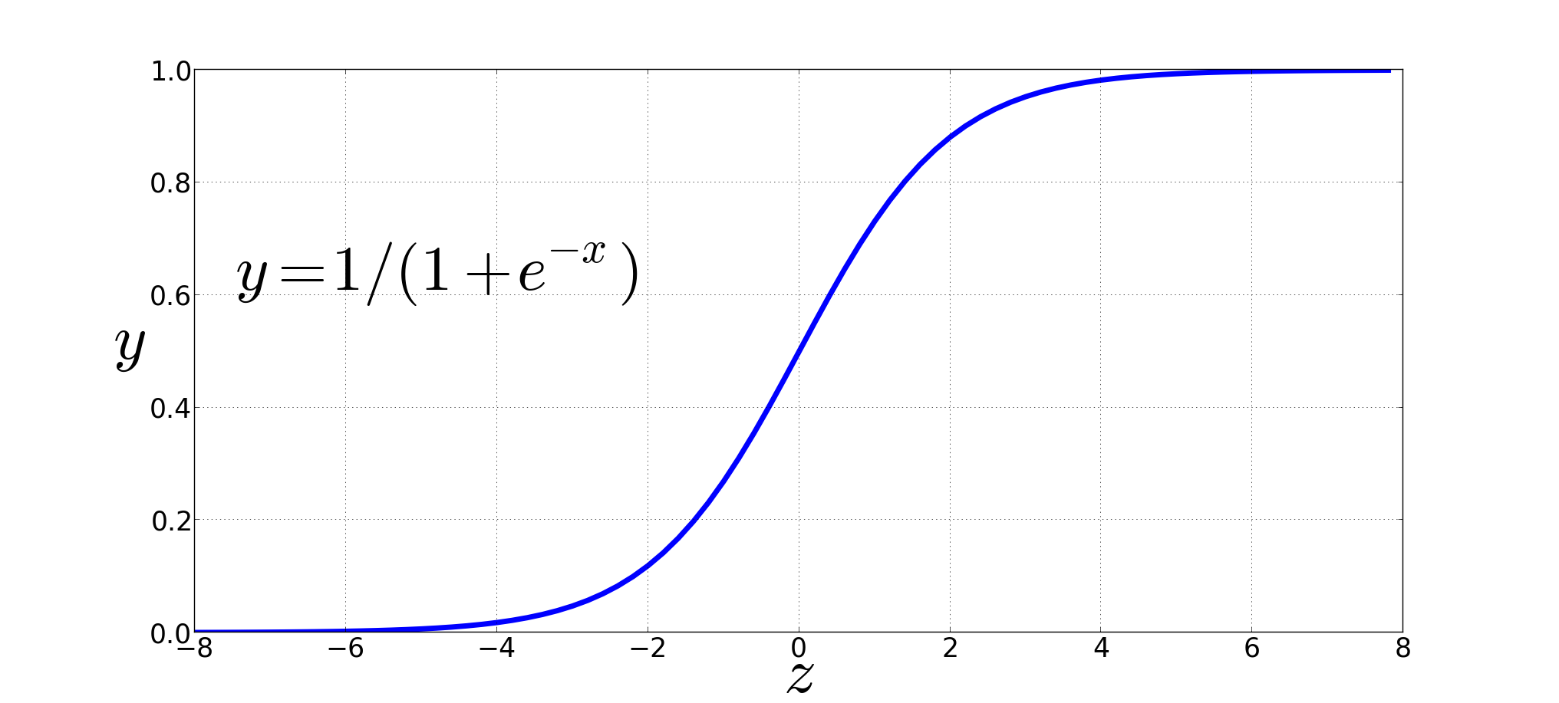
Turning dot product into a probability
Use the sigmoid (logistic) function
The sigmoid lies between 0 and 1:

Slide 61
For all the context words:
Assume all context words are independent

Slide 62
Summary so far
In summary, skip-gram trains a probabilistic classifier that, given a test target word t and its context window of k words c_{1:k}, assigns a probability based on how similar this context window is to the target word.
The probability is based on applying the logistic (sigmoid) function to the dot product of the embeddings of the target word with each context word.
We could thus compute this probability if only we had embeddings for each word target and context word in the vocabulary.
Let’s now turn to learning these embeddings (which is the real goal of training this classifier in the first place).

Slide 63
Skip-Gram Training Data
Training sentence:
... lemon, a tablespoon of apricot jam a pinch ...
c1 c2 t c3 c4
Training data: input/output pairs centering on apricot
Asssume a +/- 2 word window

Slide 64
Skip-Gram Training
Training sentence:
... lemon, a tablespoon of apricot jam a pinch ...
c1 c2 t c3 c4
For each positive example, we'll create k negative examples.
Using noise words
Any random word that isn't t

Slide 65
Skip-Gram Training
Training sentence:
... lemon, a tablespoon of apricot jam a pinch ...
c1 c2 t c3 c4
k=2

Slide 66
Choosing noise words
Could pick w according to their unigram frequency P(w)
More common to chosen then according to p_{α}(w)
α= ¾ works well because it gives rare noise words slightly higher probability
To show this, imagine two events p(a)=.99 and p(b) = .01:

Slide 67
Setup
Let's represent words as vectors of some length (say 300), randomly initialized.
So we start with 300 * V random parameters
Over the entire training set, we’d like to adjust those word vectors such that we
Maximize the similarity of the target word, context word pairs (t,c) drawn from the positive data
Minimize the similarity of the (t,c) pairs drawn from the negative data.

Slide 68
Learning the classifier
Iterative process.
We’ll start with 0 or random weights
Then adjust the word weights to
make the positive pairs more likely
and the negative pairs less likely
over the entire training set:

Slide 69
Objective Criteria
We want to maximize…
Maximize the + label for the pairs from the positive training data, and the – label for the pairs sample from the negative data.

Slide 70
Focusing on one target word t:

Slide 72
Train using gradient descent
Actually learns two separate embedding matrices W and C
Can use W and throw away C, or merge them somehow
Alternatively we can add the two embeddings together, using the summed embedding ti +ci as the new d-dimensional embedding, or we can concatenate them into an embedding of dimensionality 2d.

Slide 73
Summary: How to learn word2vec (skip-gram) embeddings
Start with V random 300-dimensional vectors as initial embeddings
Use logistic regression, the second most basic classifier used in machine learning after naïve bayes
Take a corpus and take pairs of words that co-occur as positive examples
Take pairs of words that don't co-occur as negative examples
Train the classifier to distinguish these by slowly adjusting all the embeddings to improve the classifier performance
Throw away the classifier code and keep the embeddings.

Slide 74
Query Processing in the Vector Space Model
Treat the query as a (short) (pseudo-)document. By viewing a query as a “bag of words”, we are able to treat it as a very short document
As a consequence, we can use the cosine similarity between the query vector and a document vector as a measure of the score of the document for that query.
Calculate (VSM cosine) similarity between query pseudo-document and each document in collection
Rank documents by decreasing similarity with query
Return to user in rank order (generally only top results initially)

Slide 75
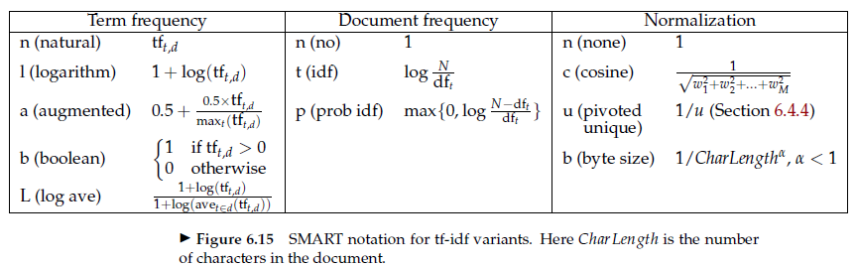
SMART Notation
The mnemonic for representing a combination of weights takes the form ddd.qqq where the first triplet gives the term weighting of the document vector, while the second triplet gives the weighting in the query vector.
The first letter in each triplet specifies the term frequency component of the weighting, the second the document frequency component, and the third the form of normalization used.
For example, a very standard weighting scheme is lnc.ltc, where the document vector has log-weighted term frequency, no idf (for both effectiveness and efficiency reasons), and cosine normalization, while the query vector uses log-weighted term frequency, idf weighting, and cosine normalization.

Slide 76
Reading
Ch 6 (pages 101 – 115, 118 – 123) in Speech and Language Processing by Jurafsky and Martin
Ch 2 (section 2.2 pages 22 – 34) in An Introduction to Information Retrieval by Manning, Raghavan and Schutze
Ch 6 (pages 117 – 133) in An Introduction to Information Retrieval by Manning, Raghavan and Schutze.
PDFs on Blackboard.

Slide 77
Practice/HW
Fetch tweets for anyone that you follow on twitter, if not search for any keywords (e.g. “Russia Investigation”) and get all the tweets.
Preprocess text
Convert text to lower case
Remove stop words
Remove punctuations
Remove white space
Remove symbols “@”, “$”, “!”
Stem the words
Create a document term matrix
Plot a bar chart showing the frequency of the words
Create a word cloud

